Slide 1
What You Need to Know About Financial Aid
August 2024

Slide 2
Topics We Will Discuss
What is financial aid?
Cost of attendance (COA)
Student aid index (SAI)
Financial need
Categories, types, and sources of financial aid
Free Application for Federal Student Aid (FAFSA®)
Special and unusual circumstances

Slide 3
What Is Financial Aid?
Financial aid consists of funds provided to students and families to help pay for postsecondary educational expenses

Slide 4
What Is Cost of Attendance (COA)?
Tuition and fees
Housing and food (living expenses)
Books, course materials, supplies and equipment
Transportation
Miscellaneous and personal

Slide 5
What Is Student Aid Index (SAI)?
Number resulting from the evaluation of a student’s (and family’s) approximate financial resources for a student’s postsecondary education
Student contribution
Parent contribution
(for dependent students)

Slide 6
What Is Financial Need?
Cost of attendance (COA) – Student aid index (SAI) = Financial need

Slide 7
Categories of Financial Aid
Need-based aid
Non-need-based aid

Slide 8
Types of Financial Aid
Scholarships
Grants
Loans
Work-Study Employment
Self-Help Aid
Gift Aid

Slide 9
Scholarships
Scholarships
Grants
Loans
Work-Study Employment
Self-Help Aid
Gift Aid

Slide 10
Grants
Scholarships
Grants
Loans
Work-Study Employment
Self-Help Aid
Gift Aid

Slide 11
Work-Study Employment
Scholarships
Grants
Loans
Work-Study Employment
Self-Help Aid
Gift Aid

Slide 12
Loans
Scholarships
Grants
Loans
Work-Study Employment
Self-Help Aid
Gift Aid

Slide 13
Sources of Financial Aid
Federal Government
Employers
States
Private Sources
College and Universities

Slide 14
Federal Government
Largest source of financial aid
Aid provided primarily based on financial need
Must apply each year using the FAFSA
Eligibility requirements must be met

Slide 15
Federal Student Aid Programs
Federal Pell Grant
Federal Supplemental Educational Opportunity Grant (FSEOG)
Teacher Education Assistance for College and Higher Education (TEACH) Grant
Federal Work-Study (FWS)
Federal Direct Student Loans (Direct Loans)
Federal Direct PLUS Loans

Slide 16
States
Residency requirements usually apply
Aid may be provided based on both merit and need
Use information from the FAFSA and/or state aid applications
Deadlines vary by state

Slide 17
Colleges and Universities
Aid provided based on both merit and financial need
Aid may be gift aid or self-help aid
Use information from the FAFSA and/or institutional applications
Deadlines and application requirements vary by institution

Slide 18
Private Sources
Foundations, businesses, churches, civic, and charitable organizations
Deadlines and applications procedures vary
Begin researching private sources early

Slide 19
Employers
May have scholarships available to the children of employees
May have educational benefits for their employees

Slide 20
Federal Student Aid Estimator
Early estimation regarding SAI and possible Title IV aid available
Requires demographic, income, and asset information
https://studentaid.gov/aid-estimator

Slide 21
Free Application for Federal Student Aid (FAFSA®)
Collects demographic and financial information
Information used to calculate the student aid index (SAI)
Colleges use SAI to offer financial aid
Available in English and Spanish

Slide 22
Free Application for Federal Student Aid (FAFSA)
May be filed at any time during an academic year, but typically no earlier than October 1st prior to the academic year for which the student requests aid
For the 2025-26 academic year, the FAFSA may be filed starting on or before December 1, 2024 (exact date to be determined)
Colleges may set FAFSA priority dates

Slide 23
Free Application for Federal Student Aid (FAFSA)
Online FAFSA
PDF FAFSA

Slide 24
Benefits of Using Online FAFSA
Built-in edits to prevent costly errors
Skip-logic allows student and/or parent to skip unnecessary questions
No need to manually enter federal tax information (FTI)

Slide 25
Benefits of Using Online FAFSA
More timely submission of original application and any necessary corrections
More detailed instructions and “help” for common questions
Ability to check application status online
Simplified application process

Slide 26
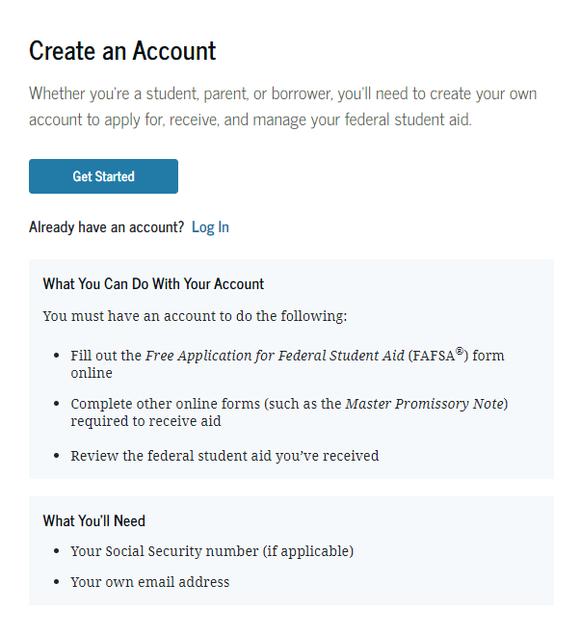
StudentAid.gov Account Username and Password (FSA ID)
Used for FAFSA completion and access to certain U.S. Department of Education websites
Student and parent must create own FSA ID
May be used throughout financial aid process, including subsequent school years
Only the owner should create an FSA ID
Apply at https://studentaid.gov/fsa-id/create-account/launch

Slide 27
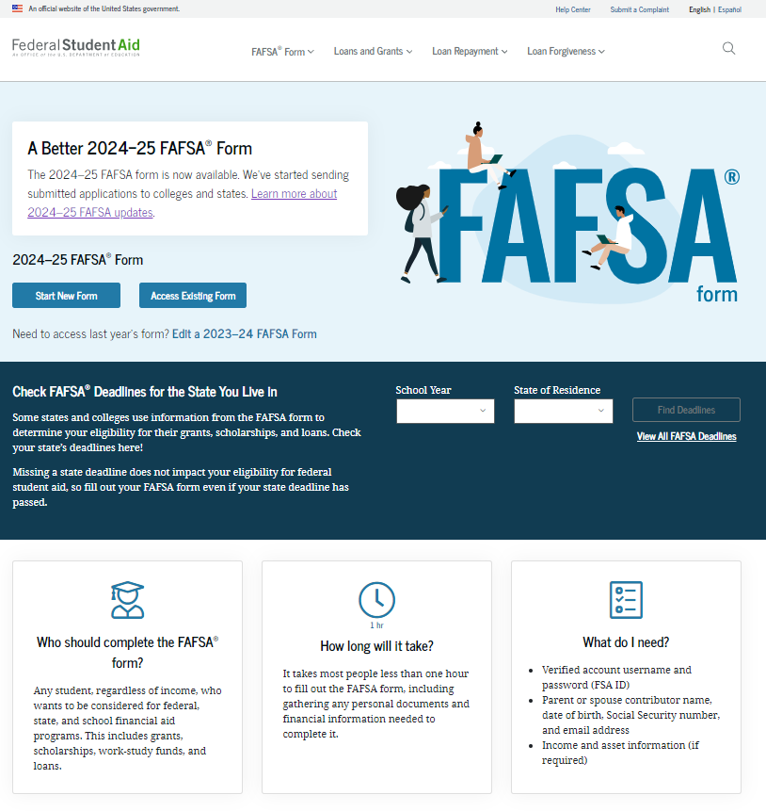
Online FAFSA

Slide 28
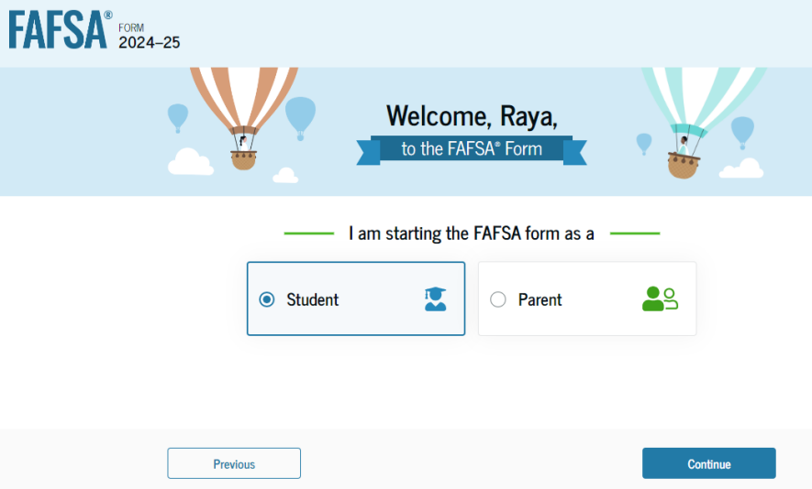
Online FAFSA
Note: Screenshot from U.S. Department of Education’s 2024-25 FAFSA Form Preview Presentation, July 2023

Slide 29
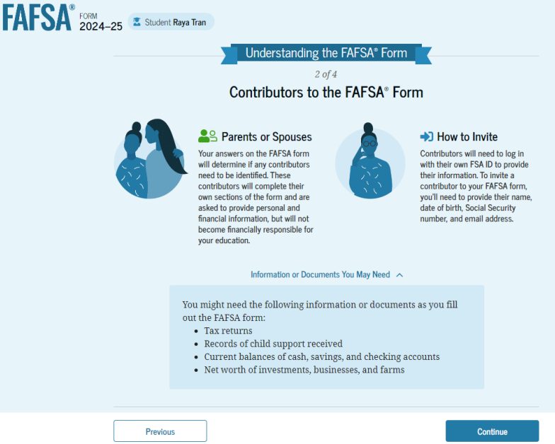
FAFSA Contributors
Note: Screenshot from U.S. Department of Education’s 2024-25 FAFSA Form Preview Presentation, July 2023

Slide 30
FUTURE Act Direct Data Exchange (FA-DDX)
Allows for an individual’s federal tax information (FTI) to be directly transferred from the IRS to the FAFSA
Consent is required by all contributors on FAFSA
IRS transfers information to populate FAFSA income questions for most tax filers
Eliminates manual entry of tax and income information

Slide 31
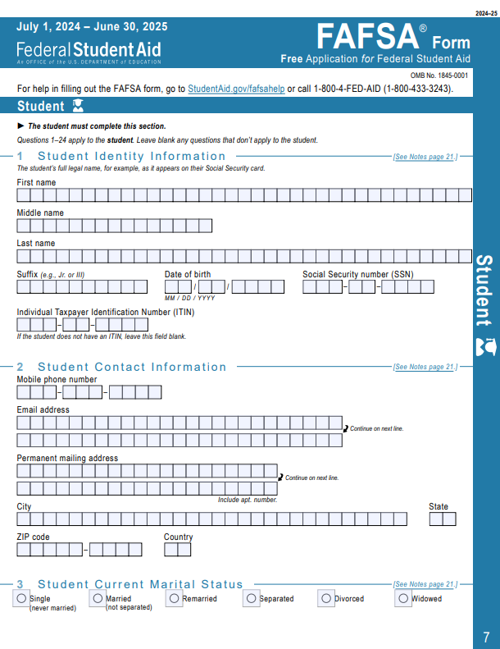
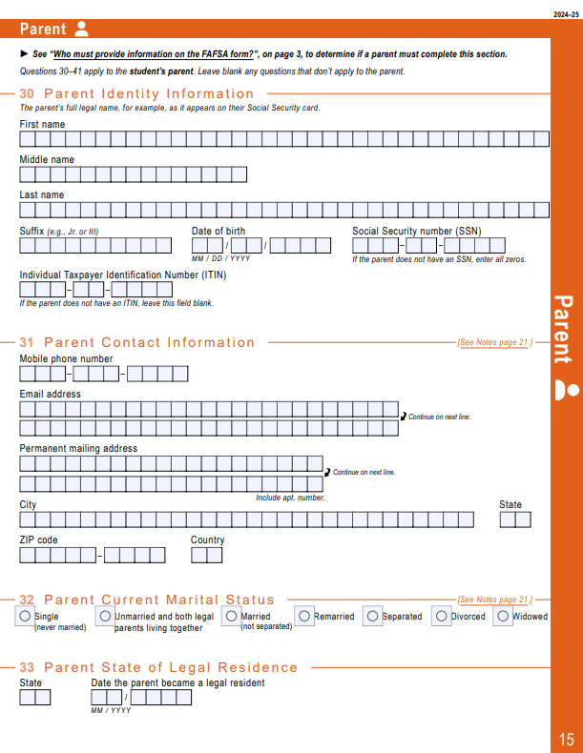
PDF FAFSA
Can use the PDF FAFSA to review questions that will be asked on online FAFSA for student and parent/s, if applicable

Slide 32
Student Information
Identity and contact information
Consent for FTI transfer from IRS
Marital status
College plans
Personal and unusual circumstances

Slide 33
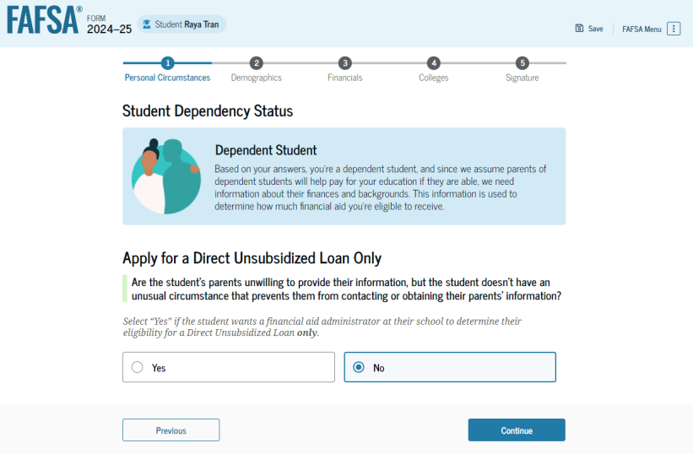
Student Dependency Status
Note: Screenshot from U.S. Department of Education’s 2024-25 FAFSA Form Preview Presentation, July 2023

Slide 34
Unusual Circumstances
Conditions that justify an institution making an adjustment to a student’s dependency status
Student does not provide parental data on FAFSA
Considered provisionally independent
Student follows institution’s process for dependency override determination

Slide 35
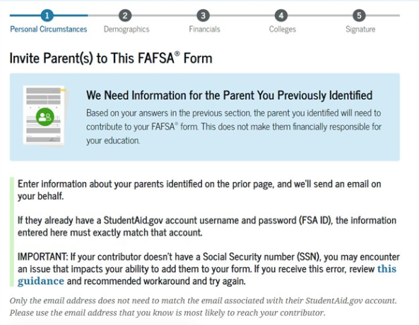
Student Invites Parents to FAFSA
Student provides personal information about parents to invite them to complete parent portion of the FAFSA
Note: Screenshot from StudentAid.gov

Slide 36
Student Information
Demographic information
Citizenship status
Parents’ education status
Parent killed in line of duty
High school information

Slide 37
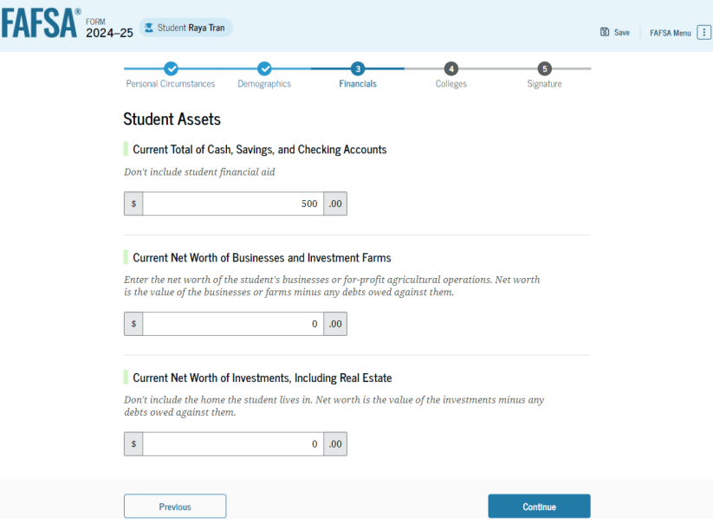
Student Financial Information
Tax return information
Minimal questions if FTI transferred from IRS
Asset information
Note: Screenshot from U.S. Department of Education’s 2024-25 FAFSA Form Preview Presentation, July 2023

Slide 38
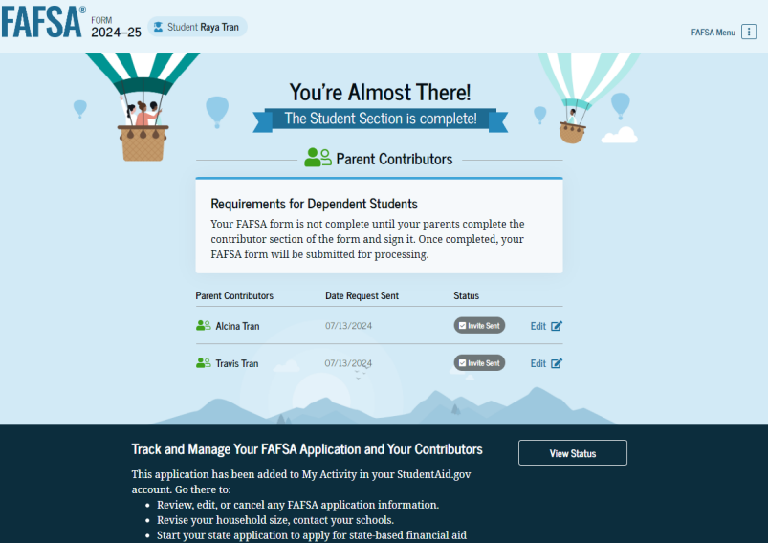
Student Section Completion
College selection
Review of information
Signature

Slide 39
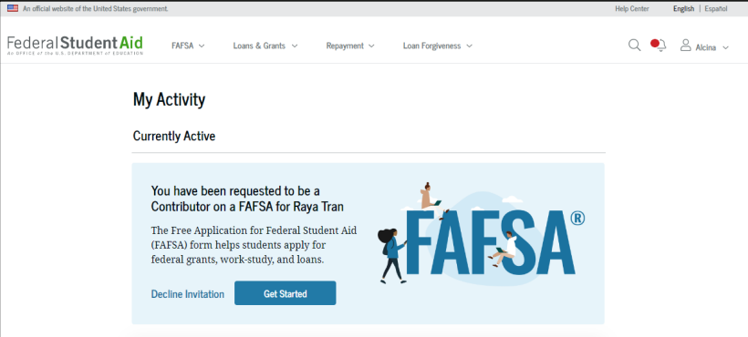
Parent Invitation
Email invitation to complete parent portion of student’s FAFSA
Parents must use FSA ID to access FAFSA
Note: Screenshot from U.S. Department of Education’s 2024-25 FAFSA Form Preview Presentation, July 2023

Slide 40
Parent Information
Identity and contact information
Consent for FTI transfer from IRS
Marital status
State of legal residence

Slide 41
Parent Financial Information
Receipt of means-tested federal benefits in the previous two years
Tax filing status
Family size and number in college
Tax return information
Minimal questions if FTI transferred from IRS
Assets
Other parent information

Slide 42
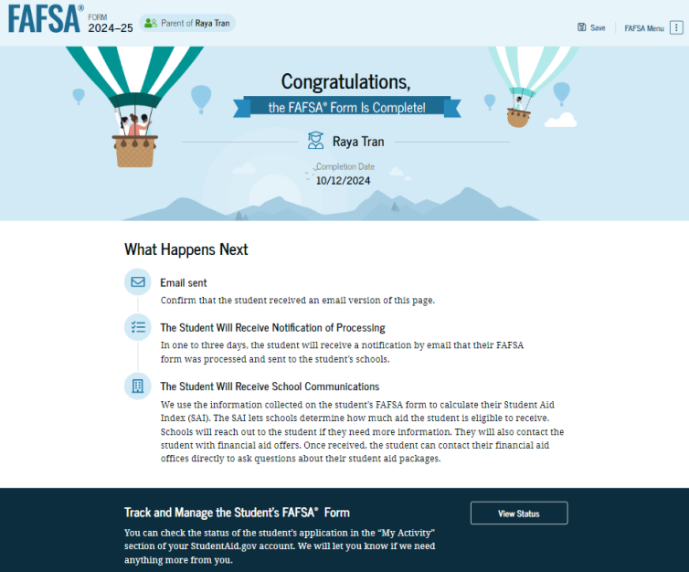
Parent Section Completion
Review of information
Signature and submission of FAFSA
Note: Screenshot from U.S. Department of Education’s 2024-25 FAFSA Form Preview Presentation, July 2023

Slide 43
Other Considerations
If independent student is married, spouse information is required as well
Consent to transfer FTI from the IRS is required for ALL contributors
Including student, student’s spouse (if applicable), parent, and other parent (if applicable)
Students, parents, and preparers may start, complete, and submit a FAFSA

Slide 44
Who Is Included in Family Size?
Dependent Applicants
Student
Independent Applicants
Parent (and spouse)
Parent’s dependent children, even if they live apart from the parent because of college enrollment*
Other people if they live with the parent*
Student (and spouse)
Student’s dependent children, even if they live apart from the student because of college enrollment*
Other people if they live with the student*
* Included only if providing more than half of their support between July 1, 2024 and June 30, 2025

Slide 45
FAFSA Processing Results
FPS
College
Student

Slide 46
FAFSA Submission Summary
Four sections:
Eligibility Overview
FAFSA Form Answers
School Information
Next Steps
Ability to print summary
Note: Screenshot from U.S. Department of Education’s 2024-25 FAFSA Form Preview Presentation, July 2023

Slide 47
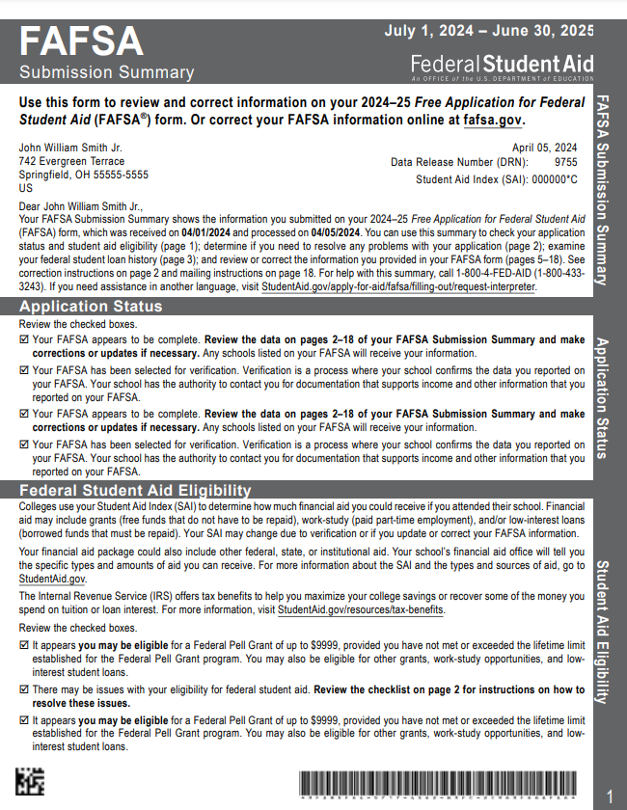
Paper FAFSA Submission Summary
Source: Federal Student Aid, Financial Aid Toolkit

Slide 48
Institutional Student Information Record (ISIR)
FPS sends results to colleges listed on the FAFSA
College reviews ISIR and may request additional documentation

Slide 49
Making Corrections
If necessary, corrections to FAFSA data may be made by:
Using online FAFSA;
Updating paper FAFSA Submission Summary; or
Submitting documentation to college’s financial aid office

Slide 50
Special Circumstances
Different than unusual circumstances (dependency overrides)
Unique conditions exist that cannot be documented with the FAFSA, or circumstances have changed since filing
Student should contact institution’s financial aid office for more information
Decisions are final and cannot be appealed to U.S. Department of Education

Slide 51
Special Circumstances
Unusual uncovered medical/dental expenses
Secondary school tuition
Extraordinary dependent care
Parent or spouse death
Additional family members in college
Loss of employment or income
Divorce

